Slide 1
Sales Forecast Analytics

Slide 2
Problem and objectives
Introduction
This project is to analyze and forecast sales of pesticides for a domestic pesticide manufacturing company (ABC Manufacturing) and analyze variables that impact the sales of the product. This will enable the pesticide company to manage the production to meet growth/slowdown in sales as per your sales forecast.
Objective
To build a data model for the following:
Conducted state wise trend analysis of the given sales.
Identified other reasons if they are influencing Pesticide sales.
State wise forecast of Pesticide sales for ABC Manufacturing.
Understand the data and develop business sense
The dataset given is related to State level sales data segregated by various pesticide manufacturing companies. This data was available on state and district level for years 2014-18.
Since the data for pesticides had been collected over the time period from 2014 to 2018, we have chosen the time series forecasting to track the sales of the pesticides over the time which helps us to understand the state wise forecast of pesticides sales and analyze the trends.

Slide 3
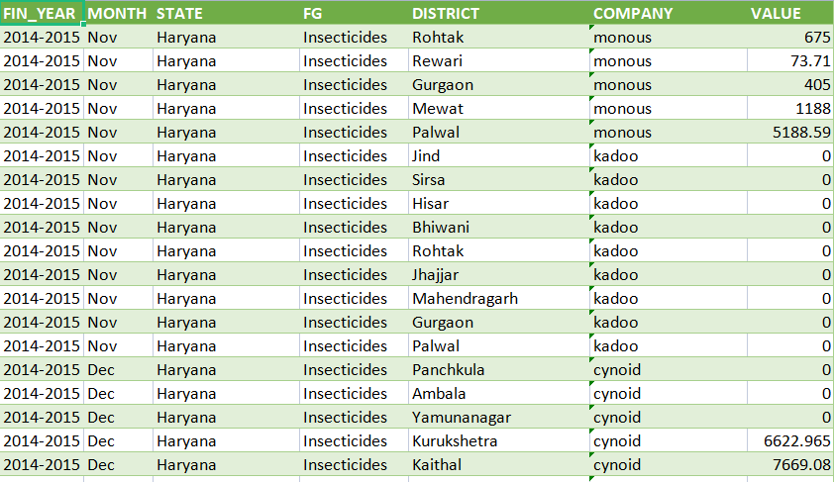
EDA, data cleaning and preparation
Understand the data set and read it into a data-frame.
Checked the missing values but we do not have any in our data set and dropped off the duplicates.
Created a new column called “Date” by combining the Fin_Year and Month.
Grouped the “Value” based on the states and reset the index as variable “Date”.
Feature engineering
Extracted the data for “ABC Manufacturing” into “ABC_df” dataframe. (Attached the screenshot in the next slide)
Created a dataframe “ABC_UP, ABC_PB, ABC_HP,ABC_ HA, ABC_UT” for respective states of ABC Manufacturing.
Grouped the “Value” by Date and resetting the index, this gives us total sales of all pesticides combined happening in that particular month.

Slide 4
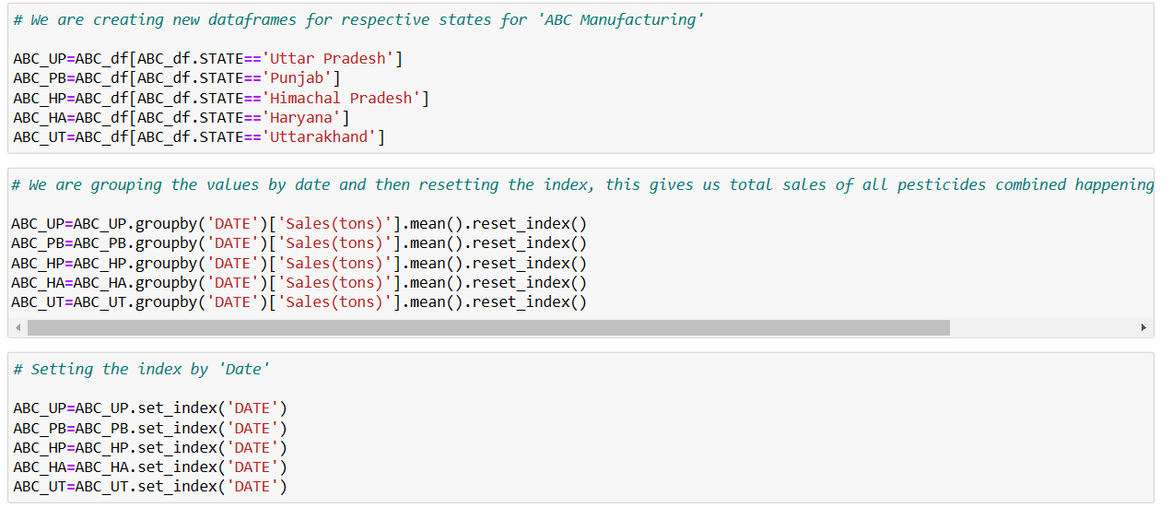
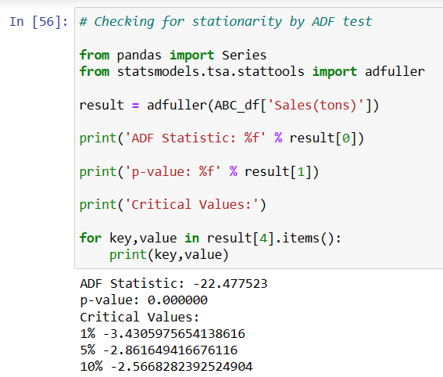
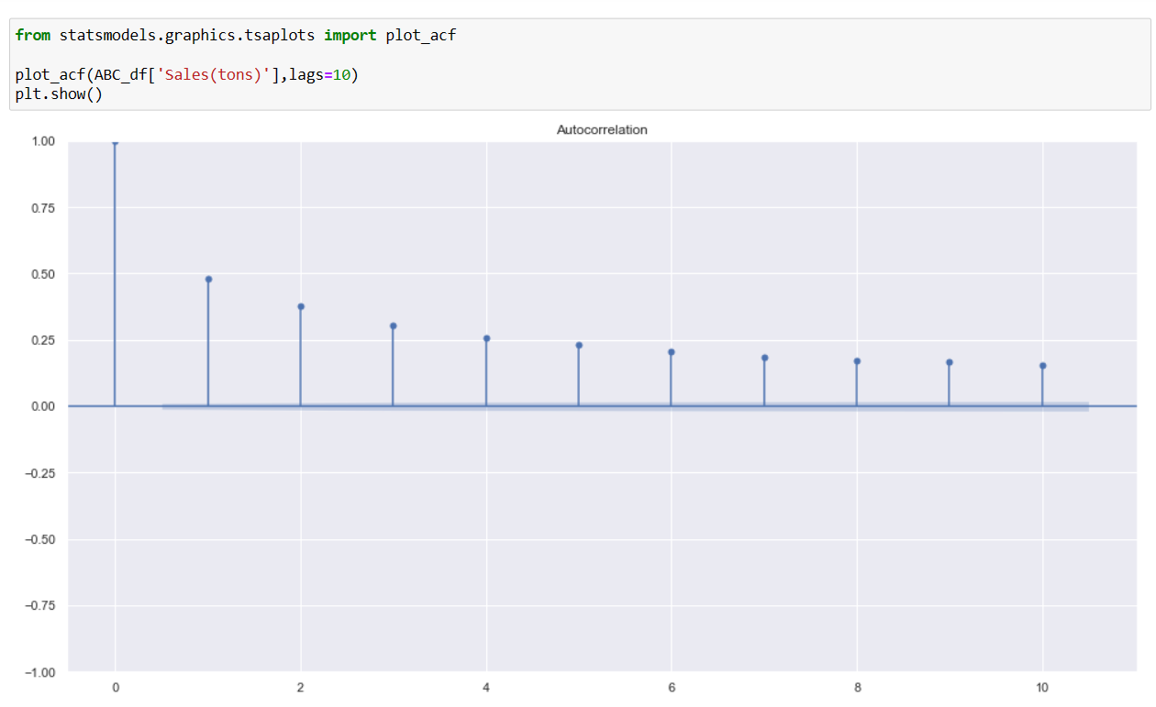
Stationarity Check:
1. Augmented Dickey Fuller test :
We have set Null Hypothesis (Ho) : Not Stationary
Hypothesis (H1) : Stationary
From the ADF test, the p-value is 0.000004, which is way below the threshold (0.05). Hence the null-hypothesis is rejected. It suggests the time series does not have a unit root, meaning it is stationary.
2. Auto Correlation Function : There are no significant autocorrelation coefficients after lag 0. This means that the stationary process is completely random with no relation with previous one.
Decomposing:
Decomposing the time series into three distinct components: trend, seasonality and noise for each state.
Divided the df of each states into Training and Testing. (Each state of ABC Manufacturing has 46 rows in the dataset, hence split 75% of data (first 34 rows) into training and 25% into testing dataset (last 12 rows) )
ADF Test
ACF Plot

Slide 5
Model Building, Cross-Validation and Visualization:
As per the plot in the previous slide, the dataset is stationary and we have seasonality and trend in it, hence we have chosen the SARIMA model.
Three models have been used for each state of ABC Manufacturing to find the optimized parameters for our time series.
Giving the values for the parameters p,d,q and Seasonality P,D and Q based on the stationarity, PACF and ACF plot.
Auto_Arima model which generates the random parameters for the attributes.
Grid search to obtain the best optimized parameters for the time series.
Uttar Pradesh:

Slide 6
Punjab:
Model 2 - Auto_Arima has MAPE value of 49.13.
Himachal Pradesh:
Model 2 - Auto_Arima has MAPE value of 144.23

Slide 7
Haryana:
Model 2 – Auto_Arima has MAPE value of 90.30.
Uttarakhand:
Model 2 - Auto_Arima has MAPE value of 33.16.

Slide 8
Observation:
1. ABC Manufacturing has been split into 5 states - Uttar Pradesh, Punjab, Himachal Pradesh, Haryana and Uttarakhand, and the forecasting has been done for each states using 3 models - a base model using parameters obtained from ACF and PACF plots, an auto_arima model, which will run various models for different parameters and give the best parameters, and hyperparameter tuning, in the form of grid search, which will run various models and then give the best optimized parameters for least MAPE (mean absolute percentage error).
2. From the above States, UP and UT seem to give a good forecast and decent MAPE for the data provided, while the rest of the States have relatively poor MAPE and fit to the forecasting.
3.MAPE is sensitive to extreme forecasted values. For eg. if the original value is 50, and the forecasted value is 400, it is 8x the original, this will significantly effect the MAPE for the model.
4. Try to improve the model further by cleaning the data either by removing the outliers using 1.5 +- IQR, or by using absolute z-score and then removing the outliers and try fitting the model again and see if this might lead to better forecast and lower MAPE.
Recommendation:
Based on the forecast of five states, we can infer that the company can expect the sales to be in an average level for the Financial year 2018-2019.

Slide 9
Thank You!

